Slide 1
Battle Cars: Mayhem & Destruction
Sleepless burrito
Slayers
Presents:
Team Members:
Andy Madruga – andym@fullsail.edu
Daniel Kahn –
Josh Fields – JFields1991@gmail.com
John Rostick – JohnRostick@gmail.com
Wade Shwallon – wadeshwallon@gmail.com

Slide 2
Game Synopsis and wheel info
In a post apocalyptic world the player must battle his way to the top, unlocking new challenges and cars. Choose from a selection of unlocked cars to battle through the game, each with their own unique stats and special ability. Collect parts, complete time trials, or just battle to the death, its your choice.
Sprint 1 – Feature Creep
Sprint 2 – Team Swap
Sprint 3 – Advertisement
Sprint 4 - Disruption

Slide 3
Responsibilities
Andy Madruga
Particle Editor/Engine
Profiles
TimeChallenge
Levels and Menus
Daniel Kahn
Art
Arcade Build
Tutorial
Levels
John Rostick
AI
Collection Mode
Levels
Josh Fields
Tile Editor/Engine
World Collision
Events & Messages
Collection Mode
Levels
Wade Shwallon
Core
Car Physics
Input
Obstacles
DeathMatch
Levels and Menus

Slide 4
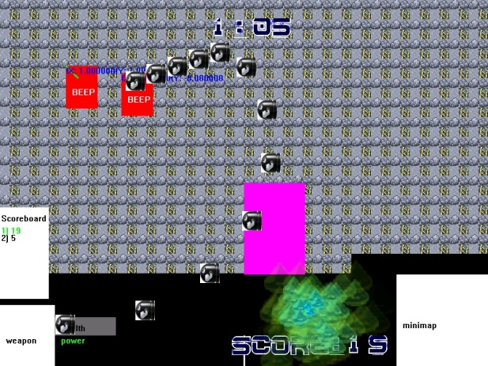
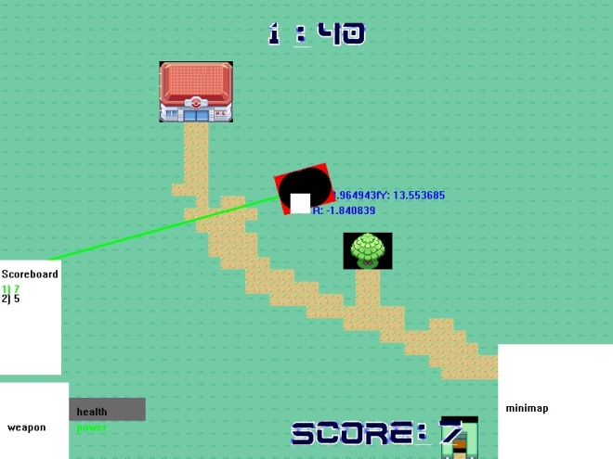
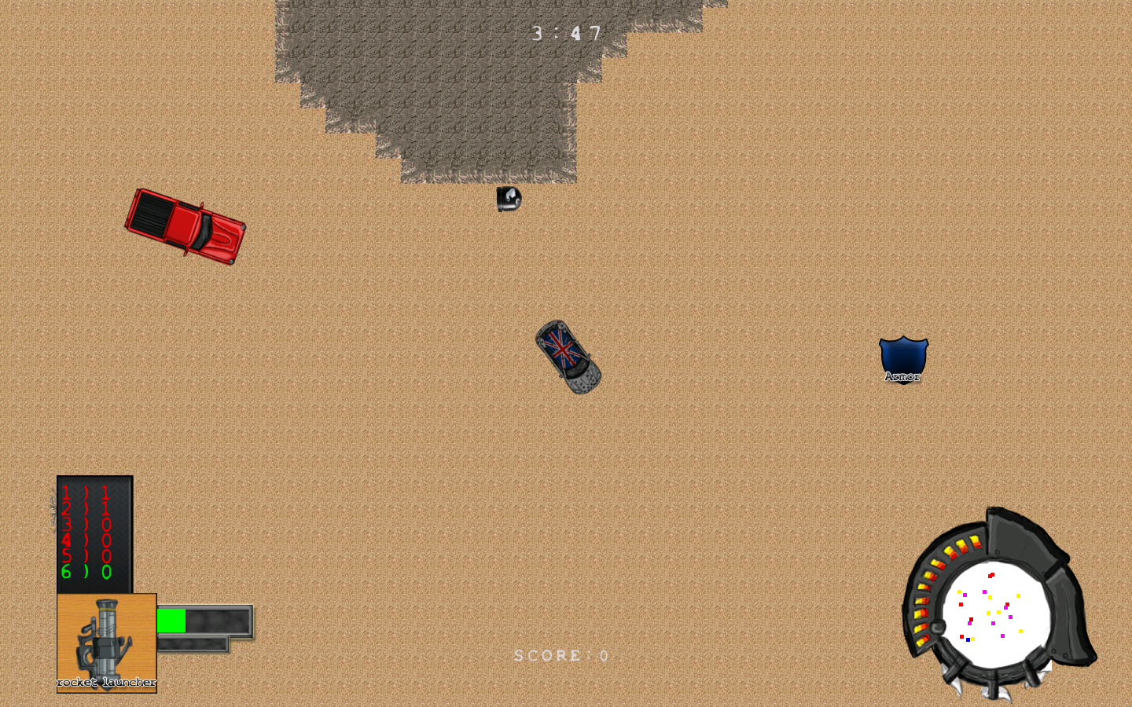
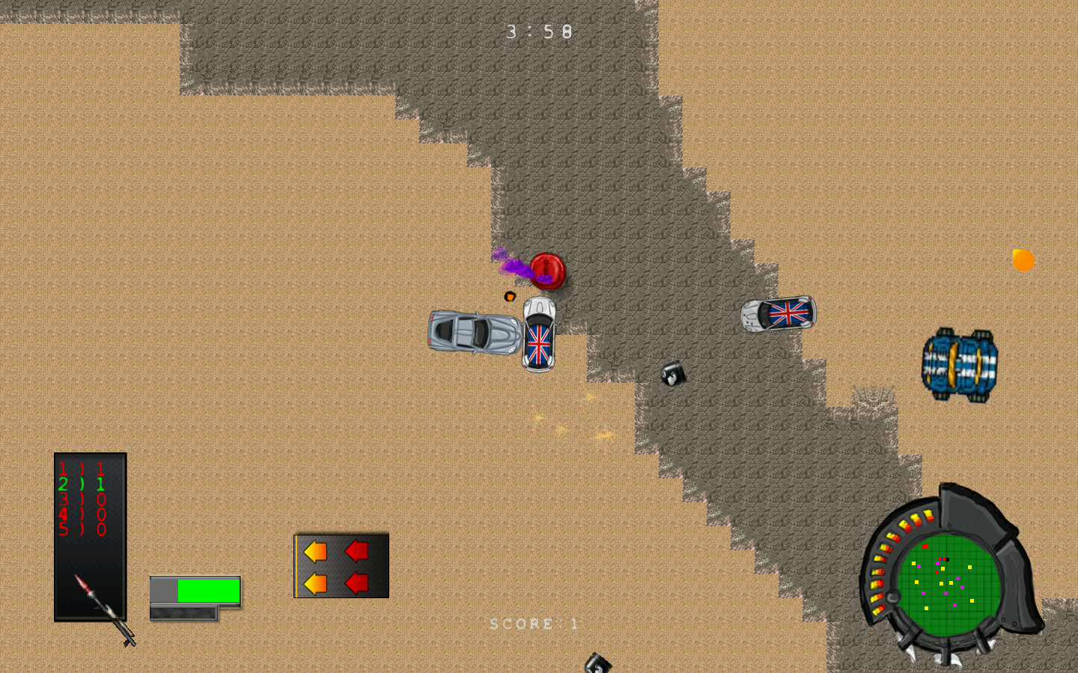
Game Progress Slide
Sprint 1
Sprint 2
Sprint 3
Gold/Sprint 4

Slide 5
Tips and Tricks Slide
Talk to your team mates
Be aware of your limits and capabilities
Do not change others code without consulting with them.
Do not have unnecessary arguments.

Slide 6
What Went Right
Team was very productive at meetings.
Picked up a new team member.
Communication between teammates
User stories finished on time.

Slide 7
What Went Wrong
Team Swap
Tile Editor
Collision Physics
Team Arguments

